Slide 1


Slide 2
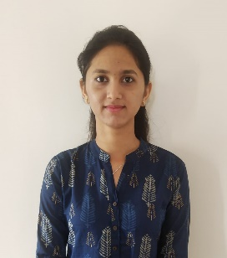
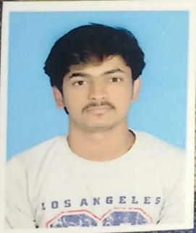
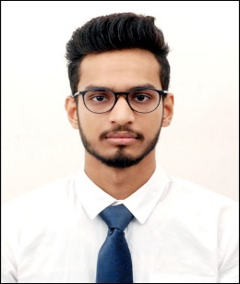
Project Highlights
Project Name : Library Management system
Team Size : 3
BU Mentor Name : Mentor PS#
Team Members Details
Ganavi Raj K G
99002534
2009MYSSPSB1
BE in information Science and Engineering
C,C++,Java,HTML
Girish
99002637
2009MYSSPSB1
BE in information Science and Engineering
C,c++,python,c#
Swarnim Shikar
99002482
2009MYSSPSB1
BE in Information Science & Engineering
C++, Python

Slide 3
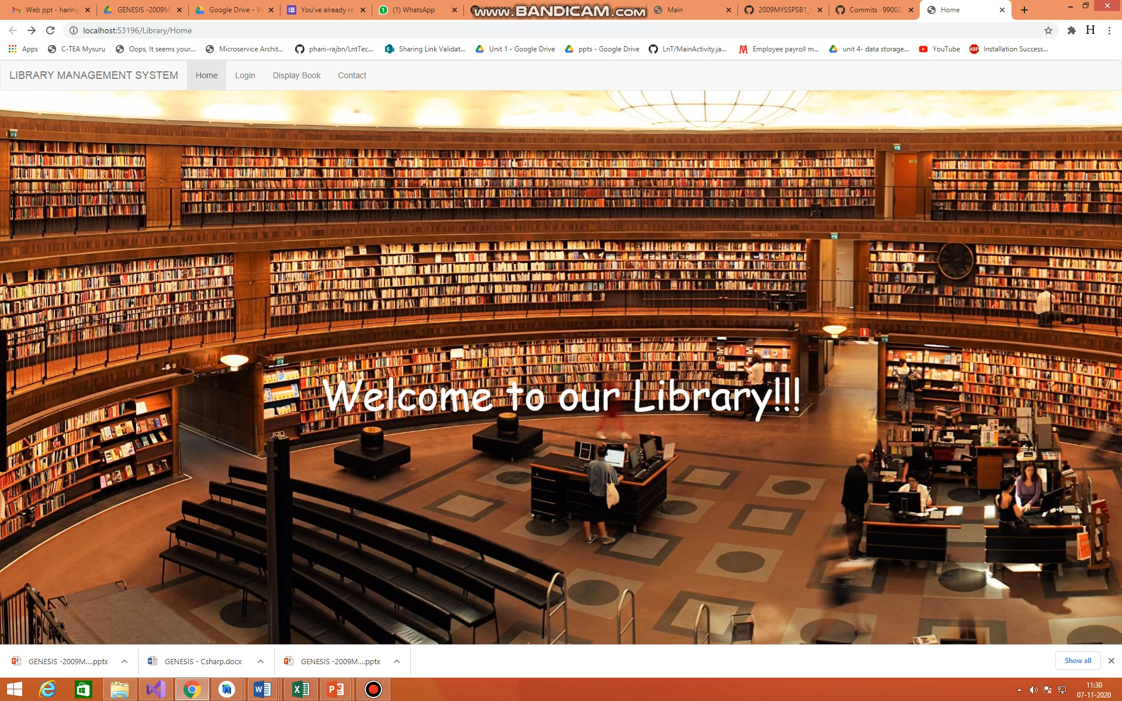
Project Video Snippet

Slide 4
Future development that can be implemented further
The project can be further extended to a real-world Library system and can be used there to handle the book management system.
The project can be deployed on cloud platforms such as Azure, AWS. No compulsion to use local storage as a database.
There can be separate access rights for admin and guest users. So, security can be improved.
With little effort, we can show Images for every book available using a database.

Slide 5


Thank You !

